Slide 1
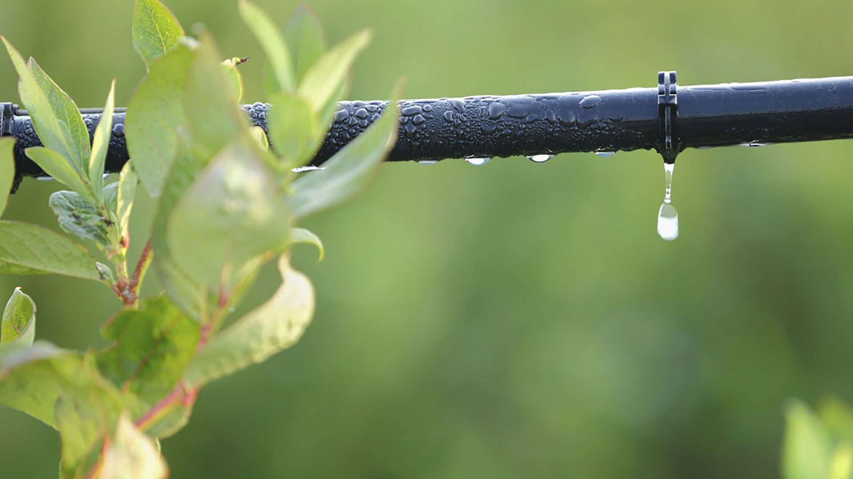
Informational Meeting – Basin Conditions November 7, 2018

Slide 2
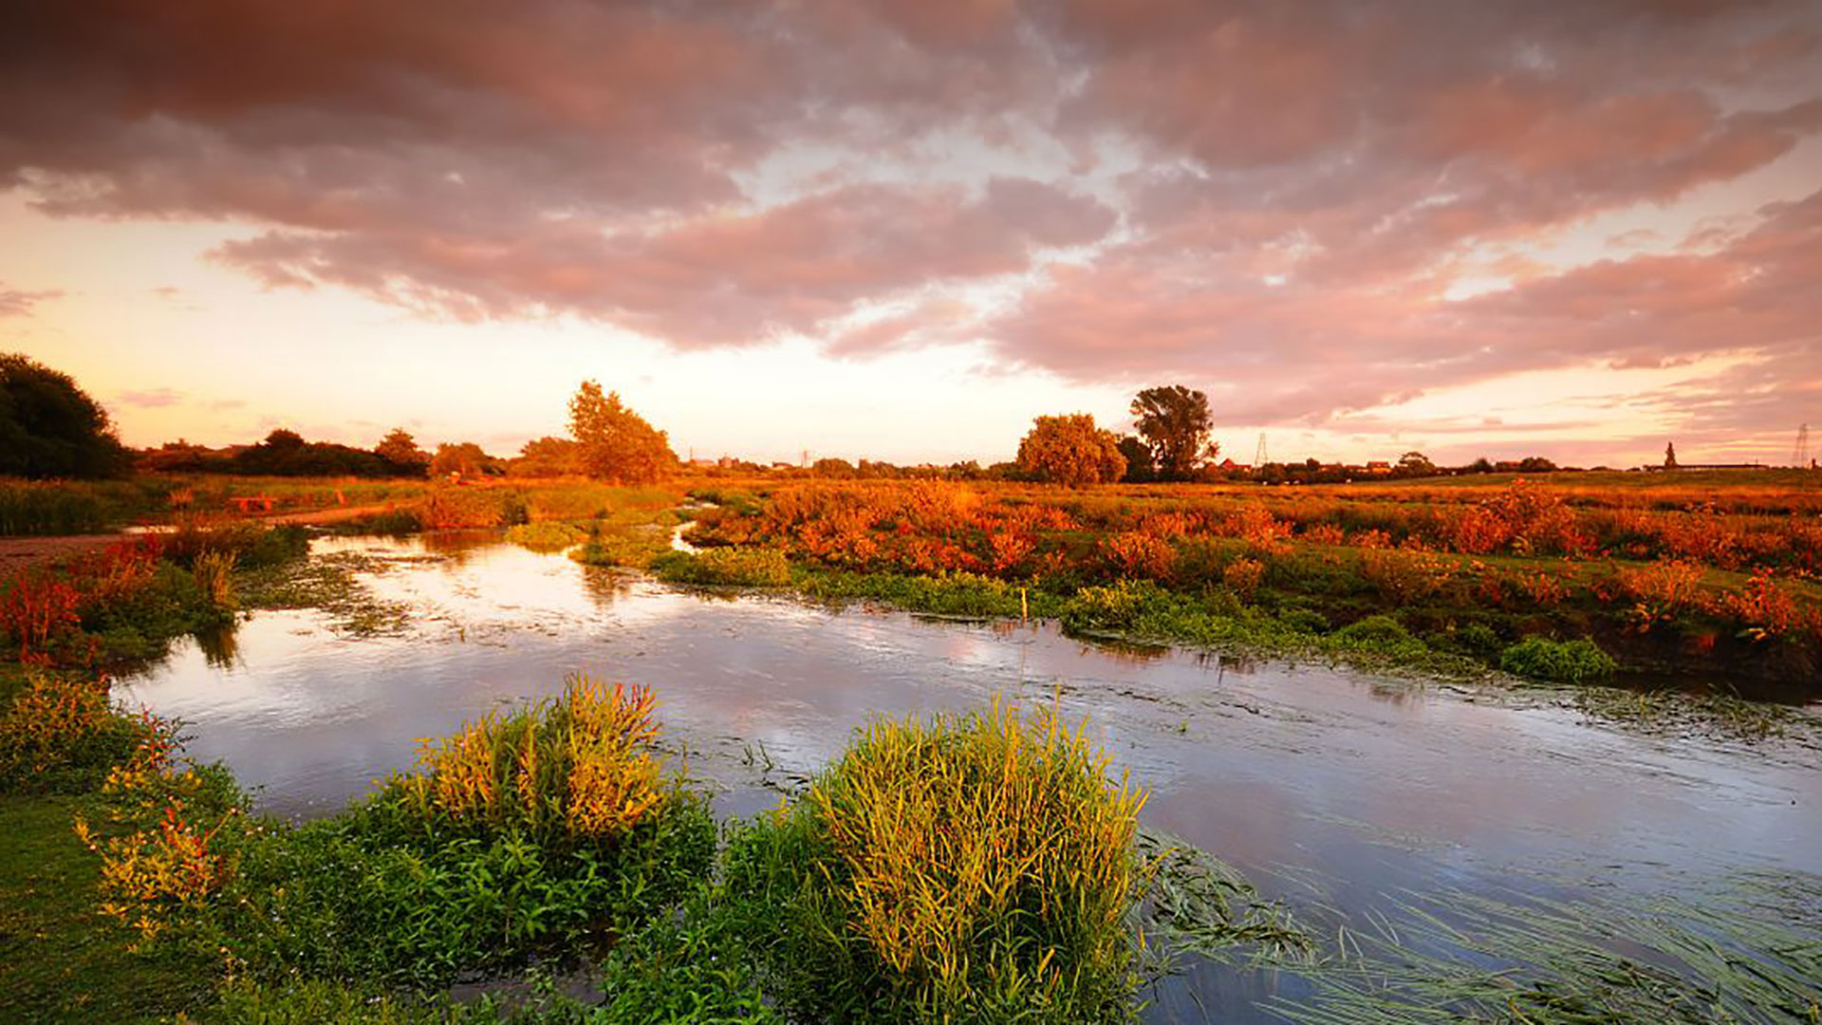
Basin Setting

Slide 3
Where is the Eastern San Joaquin Subbasin Boundary?
ESJ Subbasin boundaries:
North – Dry Creek
West – San Joaquin River
South – Stanislaus River
East – Sierra Nevada Bedrock Outcrop
1,207 square miles
3

Slide 4
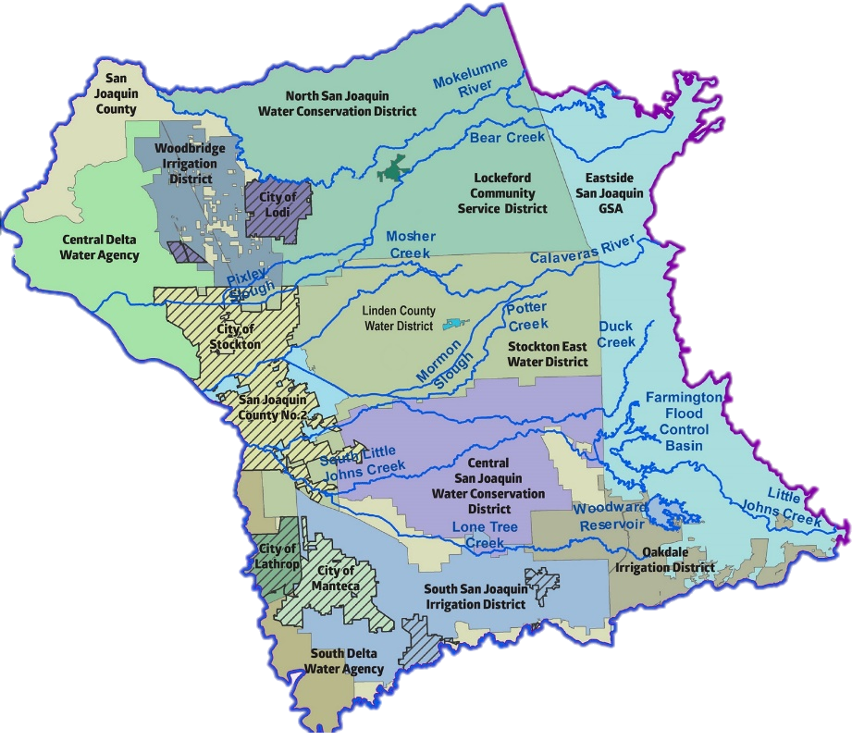
ESJ Subbasin: 17 GSAs, One GSP
17 GSAs are working collaboratively to develop a single GSP
The GSAs formed the Eastern San Joaquin Groundwater Authority (GWA) to jointly develop and implement the Eastern San Joaquin GSP
4

Slide 5
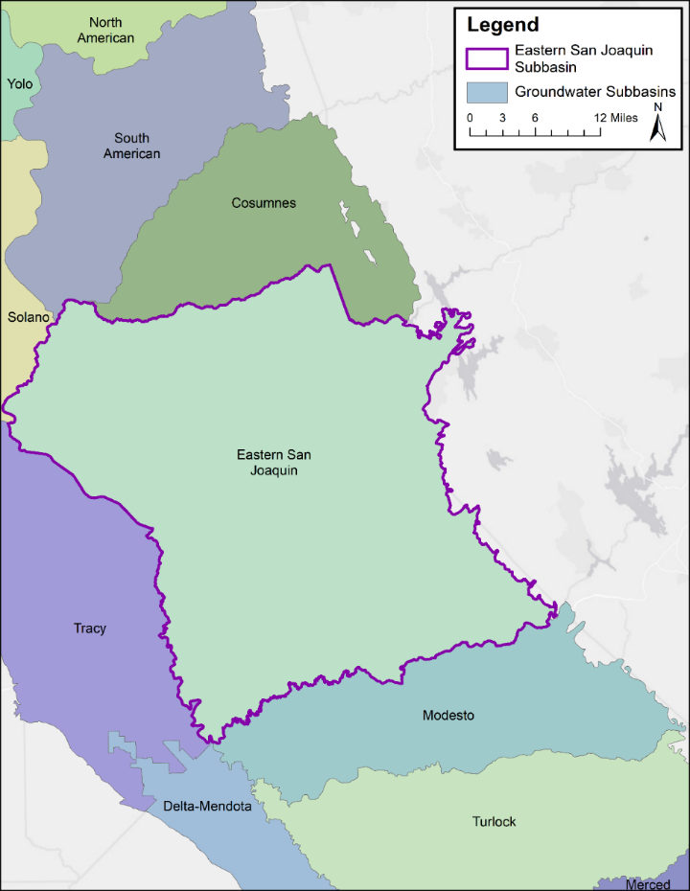
Neighboring Subbasins
Neighboring groundwater subbasins
Cosumnes
South American
Solano
Tracy
Delta-Mendota
Modesto
5

Slide 6
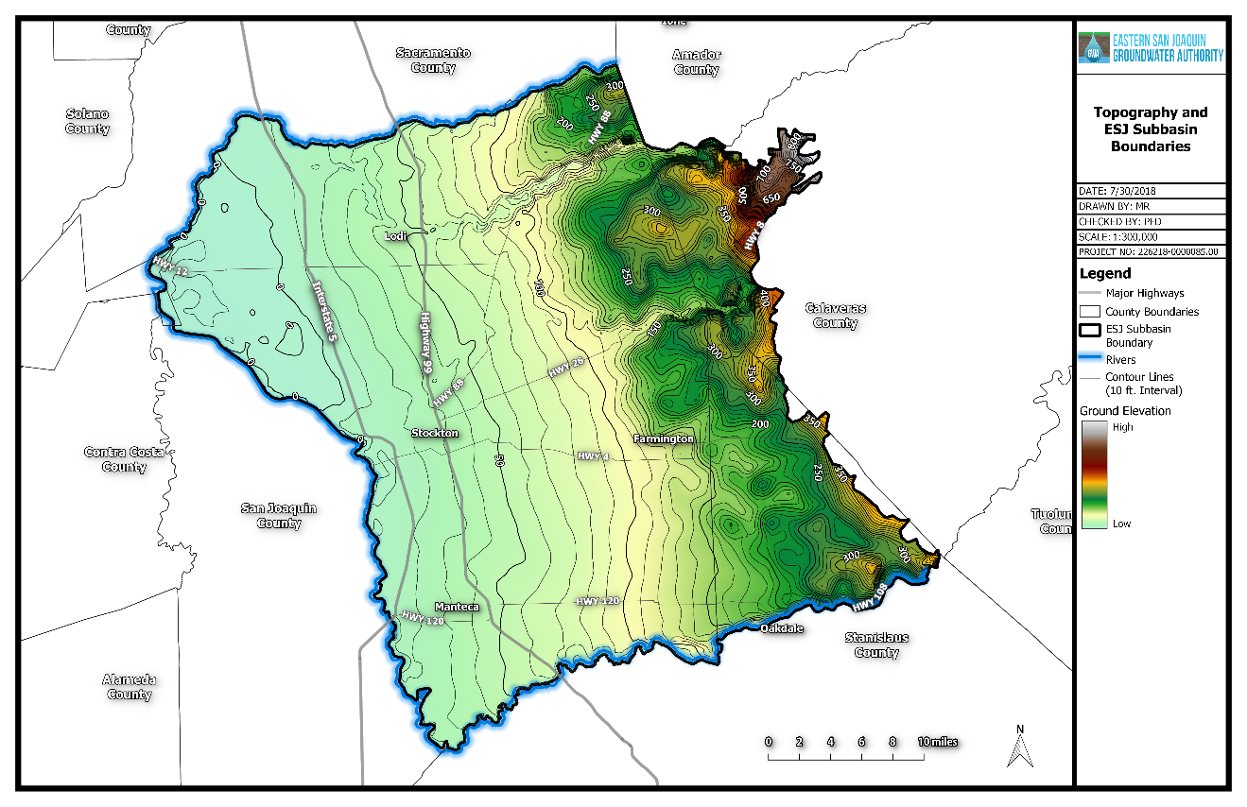
Subbasin Topography
Ground surface elevation increases as you move eastward in the subbasin, toward the Sierra Nevada foothills
6

Slide 7
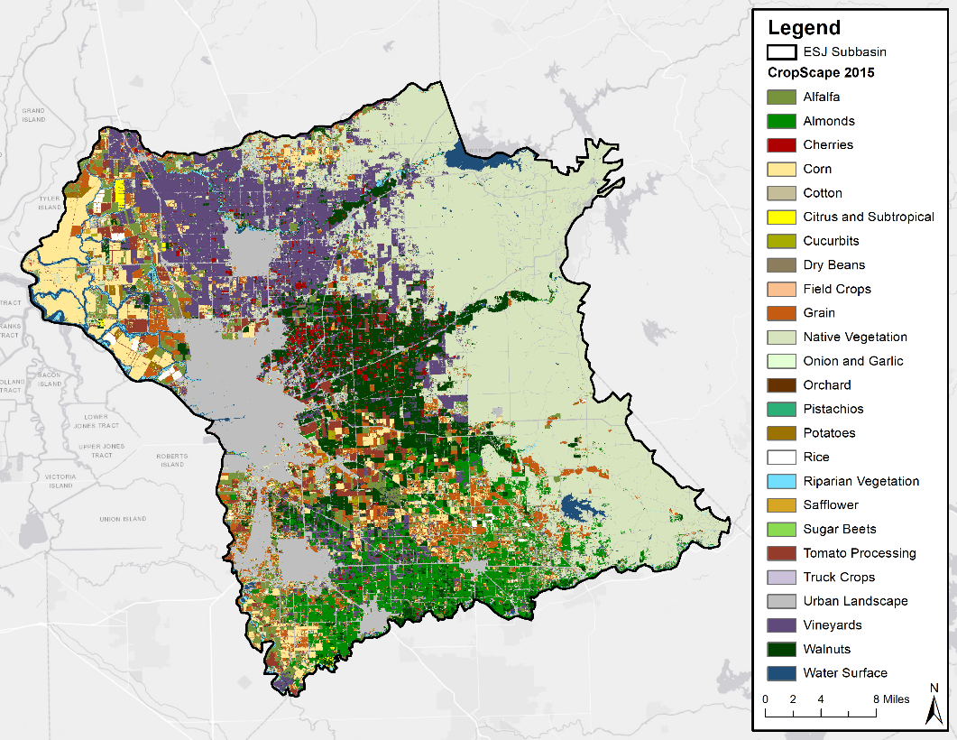
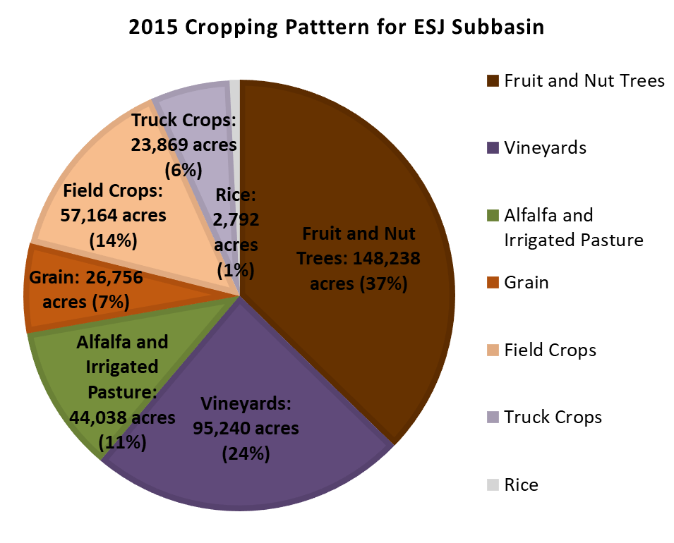
Agriculture is the Dominant Land Use in the Subbasin
7

Slide 8
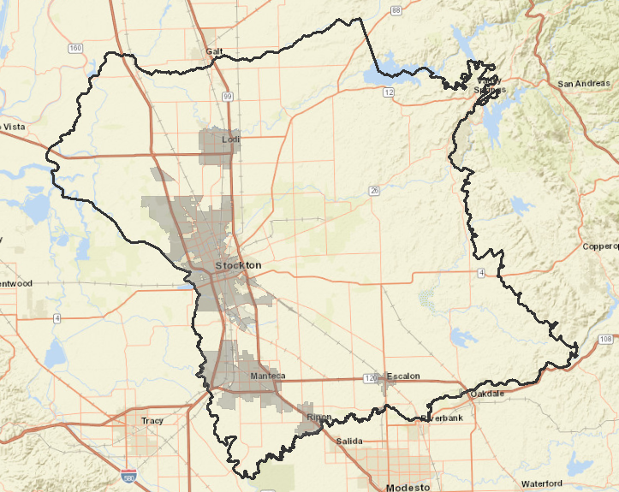
Urban Centers
Stockton
Manteca
Lathrop
Lodi
Escalon
Ripon
8

Slide 9
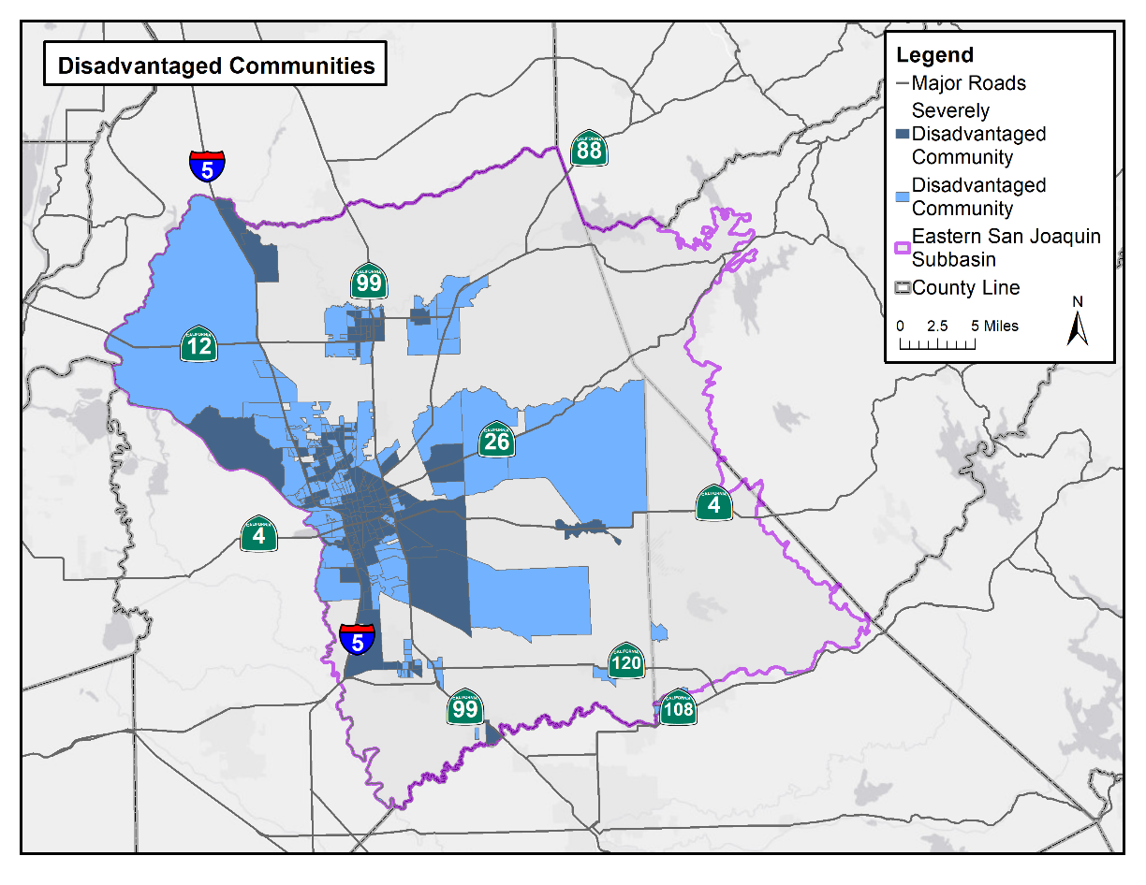
Disadvantaged Communities (DACs) in ESJ
Disadvantaged Communities (DACs) Median household income less than 80% of the statewide average
Severely Disadvantaged Communities (SDACs) Median household income less than 60% of the statewide average
9

Slide 10
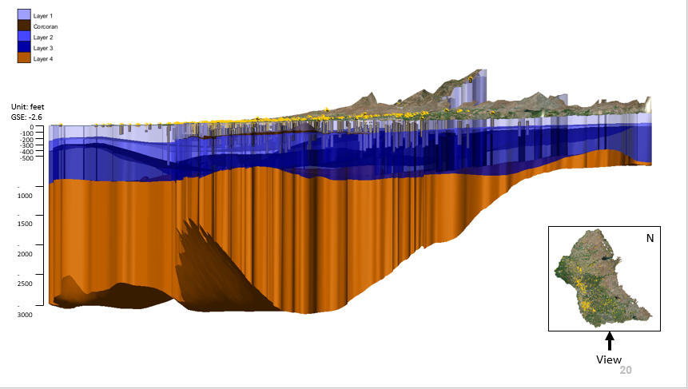
Groundwater is Stored in Aquifers Underground
] Layers 1-3 are freshwater
Layer 4 is saline
10
Notes:
We do anticipate mixing between layers 3 and 4 and will want to be aware of well placement so as not to not worse mixing if deeper wells go in

Slide 11
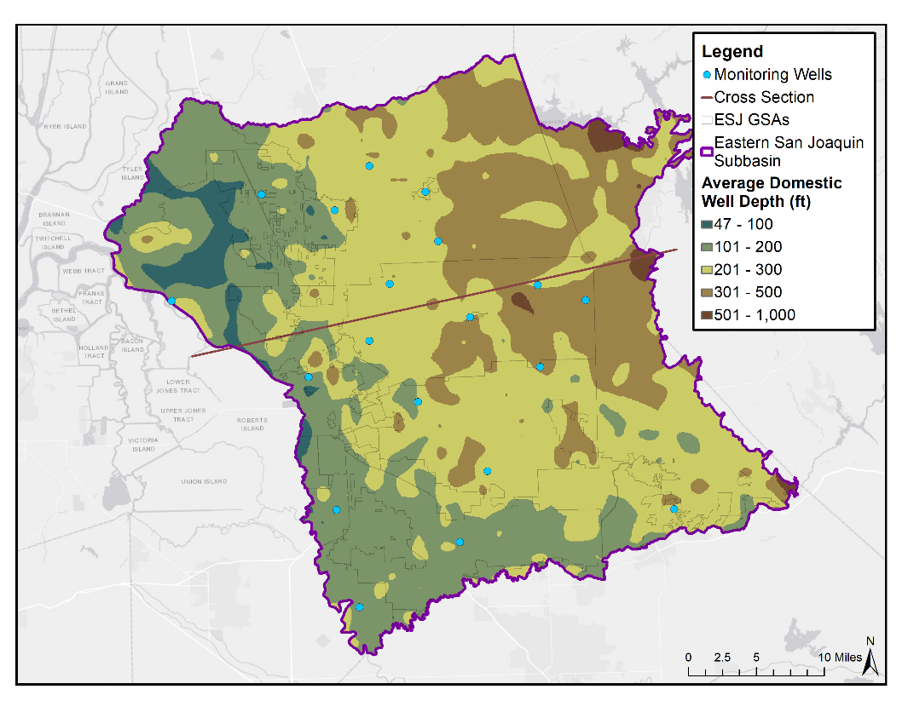
Average Domestic Well Depth
Source: Online System for Well Completion Reports (OSWCR)
11

Slide 12
Current Basin Conditions

Slide 13
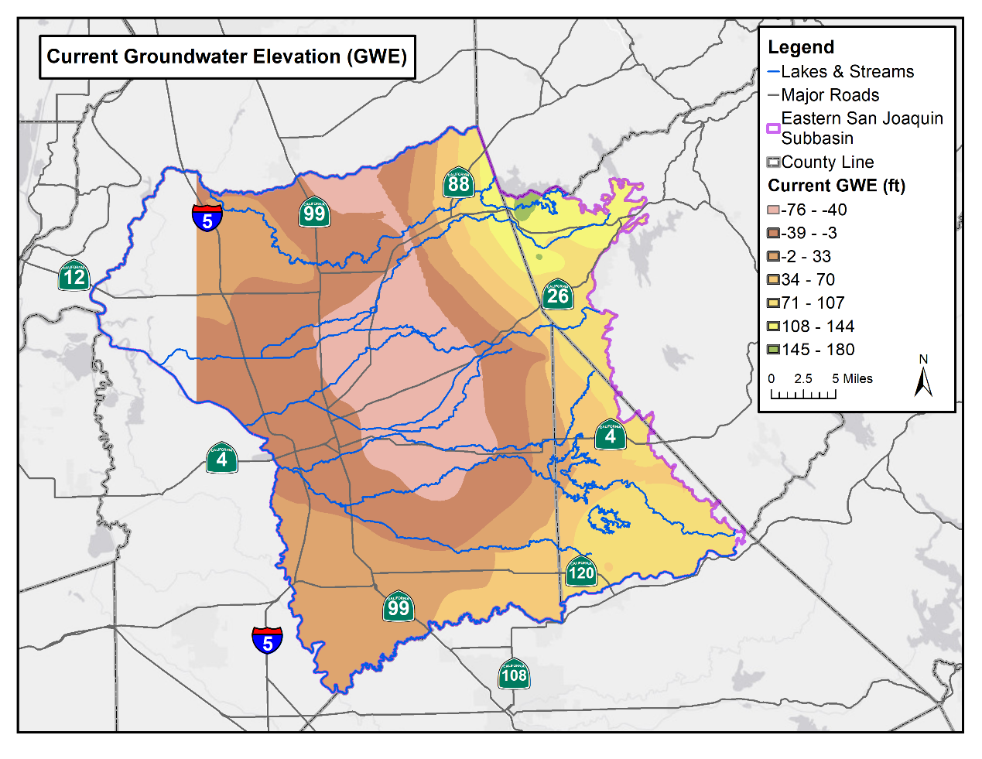
Groundwater Elevation
4th Quarter 2017 Groundwater Elevation levels in the Eastern San Joaquin Subbasin
13

Slide 14
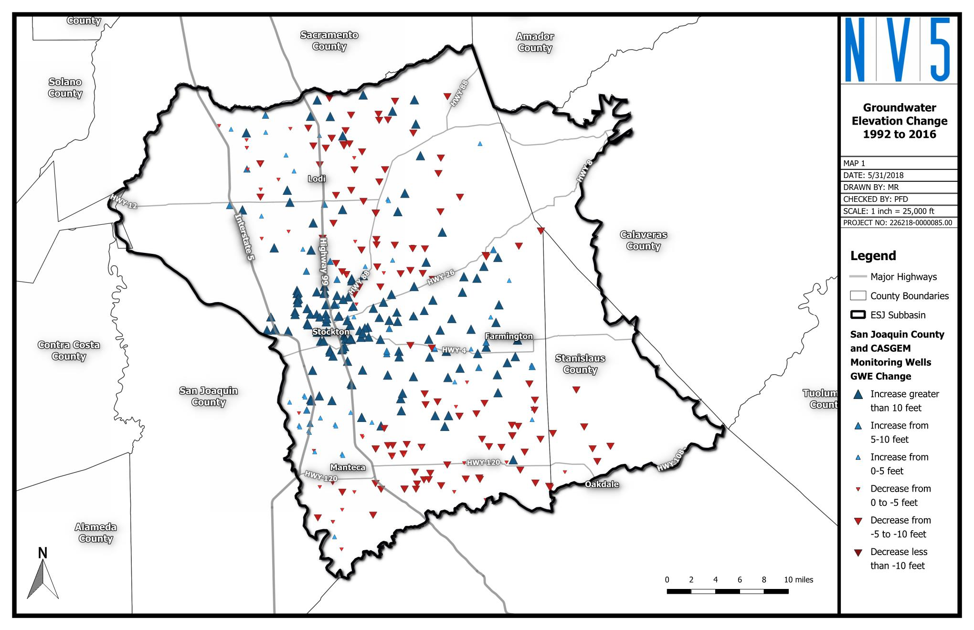
Groundwater Elevation
Some areas have recovered and some have declined since 1992 drought
(blue) – areas that have recovered since 1992
(red) – areas that have declined since 1992
14

Slide 15
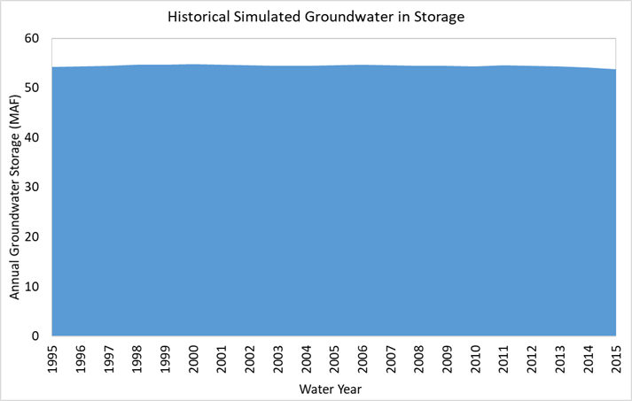
Groundwater Storage
The Basin has large amounts of groundwater in storage
This graph shows freshwater only
15

Slide 16
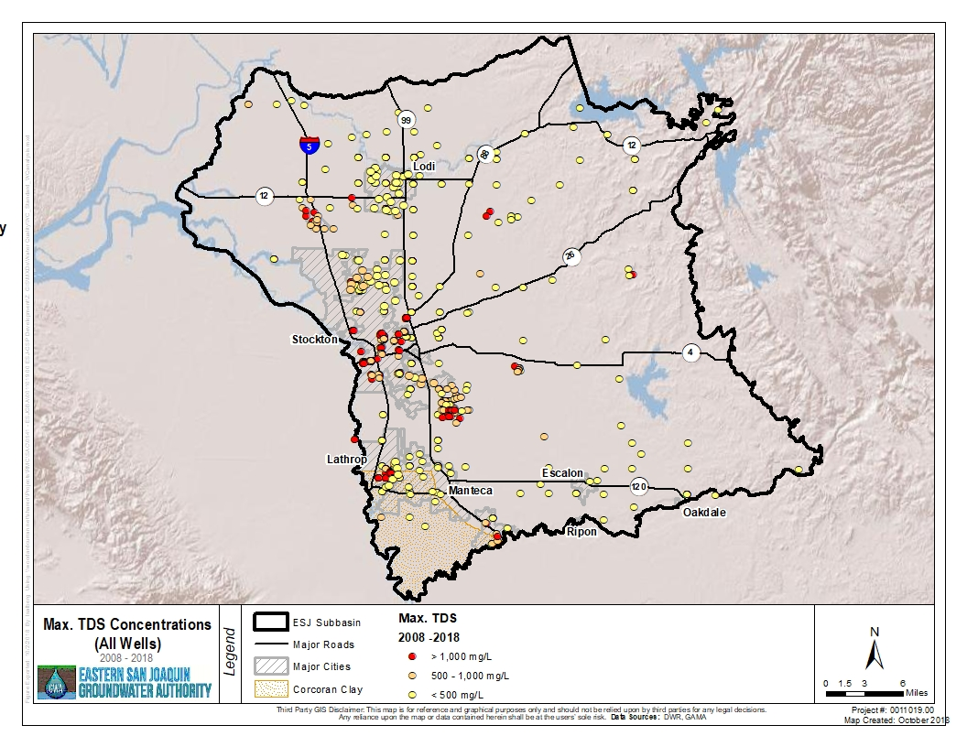
Groundwater Quality - Salinity
Salinity contamination of freshwater wells is a concern in some areas
Total Dissolved Solids (TDS) concentrations > 500 mg/L are generally found in the western half of the Subbasin
16
Notes:
Source: GAMA
Shows MAX reported TDS concentration from 2008 - 2018
Shows all wells with WQ data, including wells without known depth/construction data

Slide 17
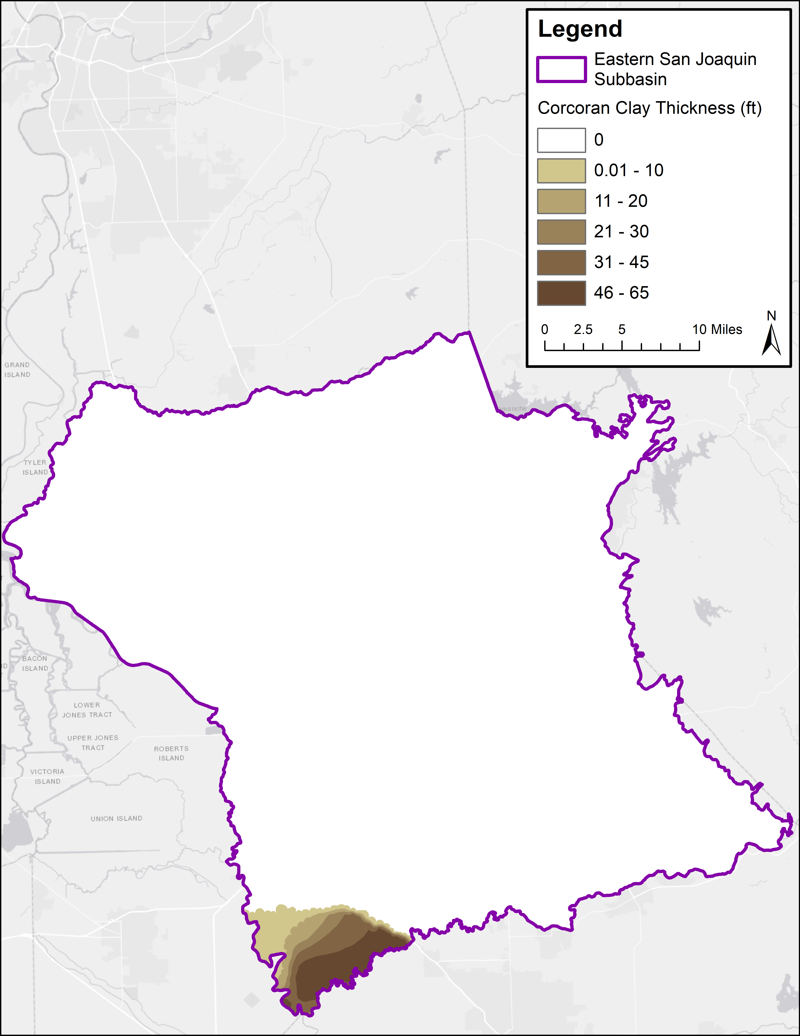
Subsidence
Contours of Corcoran
Clay Thickness
Areas with subsidence potential are generally limited to the portion of the Subbasin with a Corcoran Clay layer
Groundwater elevations in this area are typically high
Data Source: USGS, by Page (1986), Central Valley Hydrogeologic Model
17

Slide 18
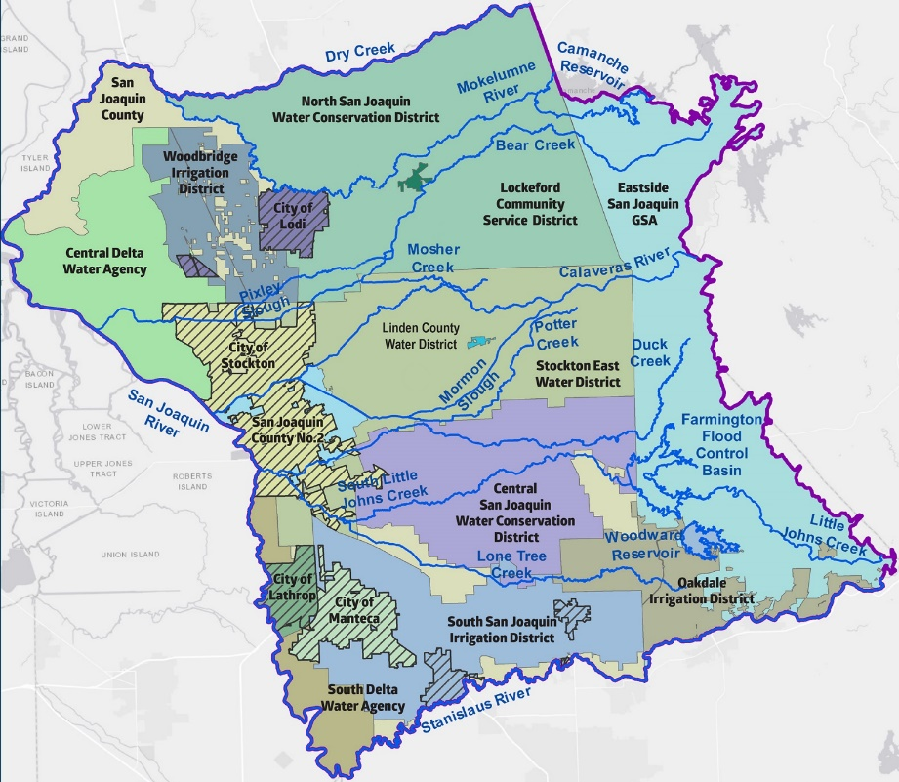
Interconnected Surface Waters
Major river systems in the Subbasin are highly managed
Instream flow requirements, water quality standards, and water rights govern upstream releases
18

Slide 19
Informational Meeting – Basin Conditions November 7, 2018

